Slide 1
Self-supervised Learning for Music Genre Classification
TaeMi Kim, SungRae Hong, Sol Lee
김태미, 홍성래, 이솔

Slide 2
Contents
Introduction
| Background
| Problem Definition
Related Work
| Self-Supervised Learning
| Siamese Network
| SimCLR, BYOL, SimSiam
| Self-Supervised Learning for Music Classification
Method
| Proposed Architecture
| Audio Augmentation
| Image Augmentation
| Augmentation Results
Experiment
| Dataset
| Experimental Setup
| Result
Discussion & Conclusion
| Discussion
| Conclusion

Slide 3
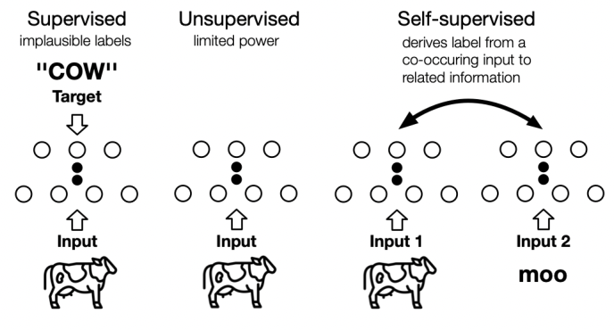
1. Introduction
| Background
DL has achieved great success in many fields, such as computer vision and natural language processing
Require well-refined and well-defined large amounts of datasets (heavy dependence on manual labels)
Ex) JFT-300M (Google), IG-1B-Targeted (META)
Learning without labels is cost-effective and more robust to data imbalance [1]
Self-supervised learning, learns useful representation from large amounts of label-free data
Ex) SimCLR, BYOL, Dino, SimSiam
Those studies have focused on the methodology itself, conducted only in image domains (Easy to augment and process)
[1] Liu, Hong, Jeff Z. HaoChen, Adrien Gaidon and Tengyu Ma. “Self-supervised Learning is More Robust to Dataset Imbalance.” ArXiv abs/2110.05025 (2021): n. pag.

Slide 4
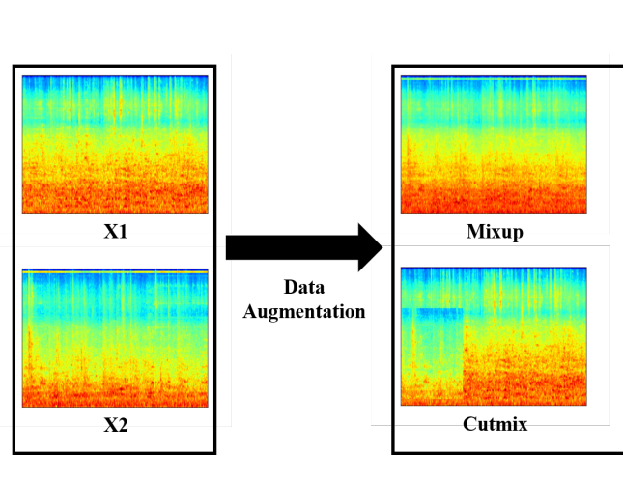
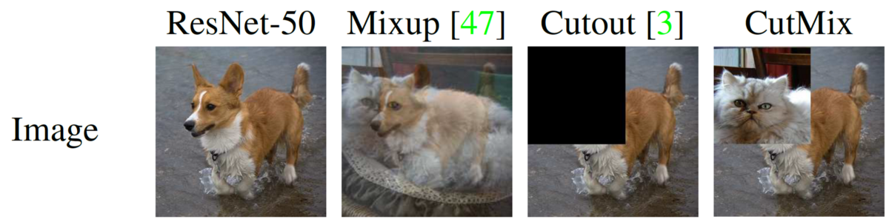
1. Introduction
| Problem Definition
"How to apply SSL well to downstream tasks of music domain?"
Music labels include genres, instrumentation, mood, etc. including the tagger's judgment, and the possibility of mislabeling is high.
it also includes a lot of time and money. [2]
Attempts to apply SSL to several downstream tasks in the music domain [3] [4] [5] [6]
Data augmentation is an important process to prevent the collapsing problem, which is a major problem in learning SSL
Only limited augmentation methodology is used in these studies, more augmentation methodology needs to be applied!
Perform SSL(music genre classification task) by processing audio data into images and applying diverse image augmentation methodologies
Identify the possibility of applying more diverse image augmentation methodologies to audio data
[2] Choi, Keunwoo et al. “The Effects of Noisy Labels on Deep Convolutional Neural Networks for Music Classification.” (2017).
[3] Park, Jiyoung et al. “Representation Learning of Music Using Artist Labels.” ISMIR (2018).
[4] Spijkervet, Janne and John Ashley Burgoyne. “Contrastive Learning of Musical Representations.” ISMIR (2021).
[5] Wu, Ho-Hsiang et al. “Multi-Task Self-Supervised Pre-Training for Music Classification.” ICASSP 2021 - 2021 IEEE International Conference on Acoustics, Speech and Signal Processing (ICASSP) (2021): 556-560.
[6] Zhao, Han et al. “S3T: Self-Supervised Pre-training with Swin Transformer for Music Classification.” ArXiv abs/2202.10139 (2022): n. pag.

Slide 5
2. Related Work

Slide 6
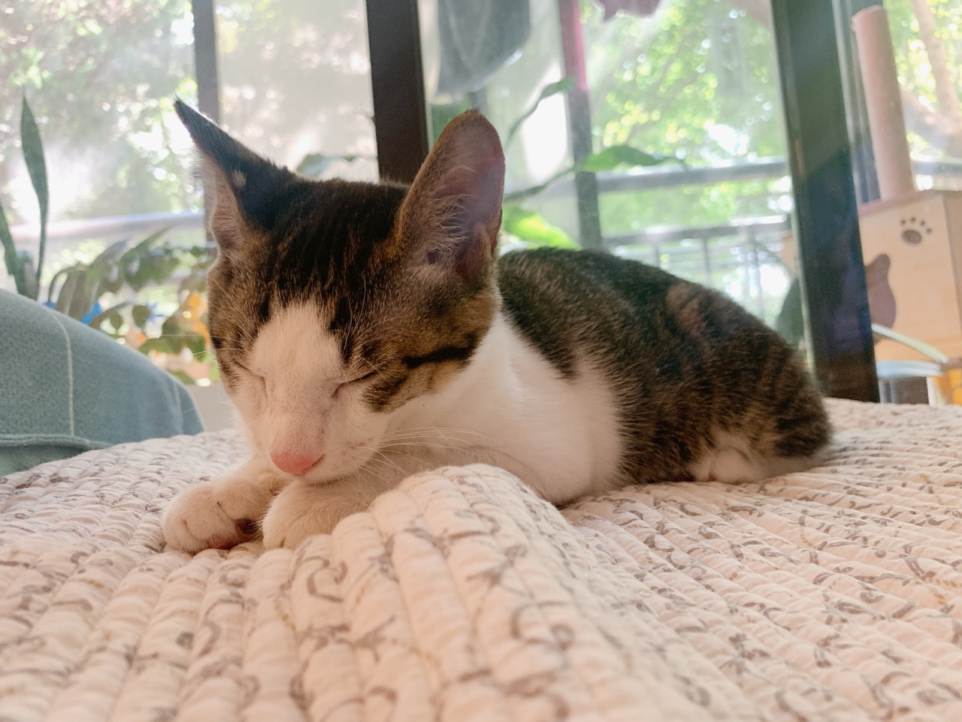
2. Related Work
| Self-Supervised Learning
Cat?
finetuned
Model
Model
Dog?
Pretext Task (ex. predicting rotation)
Downstream Task (ex. classification)
Step1
Step2
Self-Supervised Pretraining
pretext task
contrastive learning
Transfer Learning
from the model trained in Step1

Slide 7
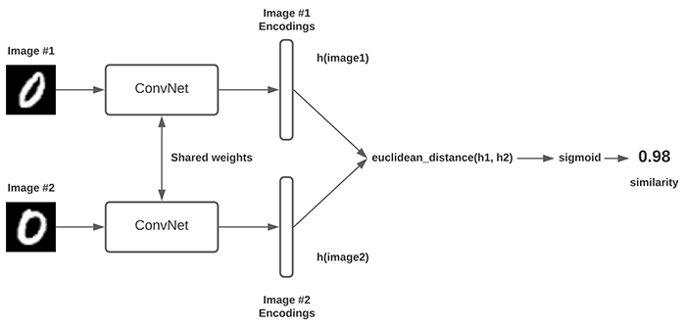
2. Related Work
| Siamese Network
Forcing models to embed two inputs in the same class similarly.
Collapsing Problem: All outputs collapse to a constant

Slide 8
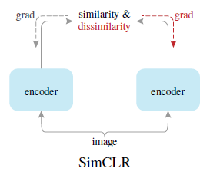
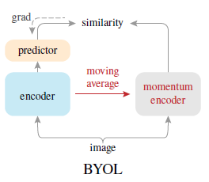
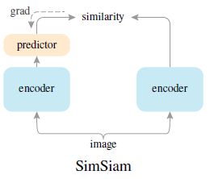
2. Related Work
| SimCLR, BYOL, SimSiam
[7]
[8]
[9]
Negative Samples
Large Batch Size
Contrastive Loss
Momentum Encoder
Exponential Moving Average
Stop Gradient
Stop Gradient
SimCLR without negative samples
BYOL without momentum encoder
[7] Chen, Ting, et al. "A simple framework for contrastive learning of visual representations." International conference on machine learning. PMLR, 2020.
[8] Grill, Jean-Bastien, et al. "Bootstrap your own latent-a new approach to self-supervised learning." Advances in Neural Information Processing Systems 33, 2020.
[9] Chen, Xinlei, and Kaiming He. "Exploring simple siamese representation learning." Proceedings of the IEEE/CVF Conference on Computer Vision and Pattern Recognition. 2021.

Slide 9
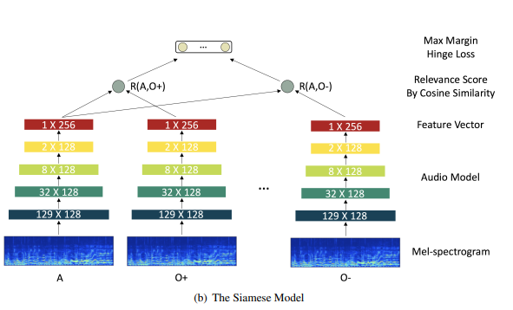
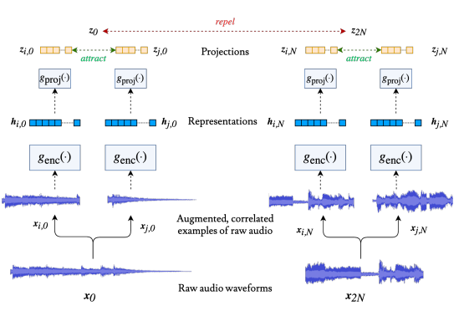
2. Related Work
| Self-Supervised Learning for Music Classification
Representation Learning of Music Using Artist Labels (2017) [3]
Contrastive Learning of Musical Representations (2021) [4]
SSL using artist labels
Negative samples
Relevance score
Max-margin hinge loss
SimCLR for music domain
Negative samples
Contrastive Loss
[3] Park, Jiyoung et al. “Representation Learning of Music Using Artist Labels.” ISMIR (2018).
[4] Spijkervet, Janne and John Ashley Burgoyne. “Contrastive Learning of Musical Representations.” ISMIR (2021).

Slide 10
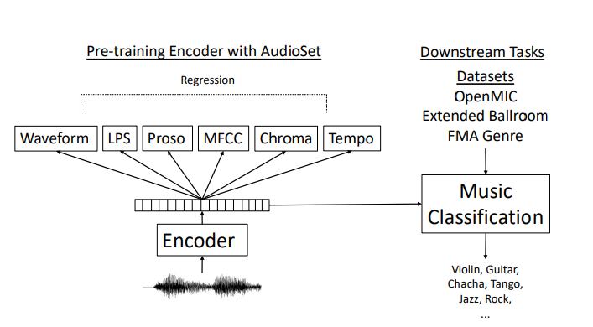
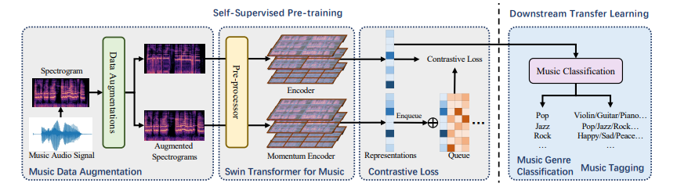
2. Related Work
| Self-Supervised Learning for Music Classification
Multi-Task Self-Supervised Pretraining for Music Classification (2021) [5]
S3T: Self-Supervised pretraining with Swin Transformer for Music Classification (2022) [6]
combine self-supervised and multi-task learning
Equal weighted + Re-weighted loss
combining the Swin Transformer with a self-supervised learning (MoCo)
Negative samples
Contrastive Loss
A huge amount of data is used. (at least 1 million)
Audio augmentation methods are limited
[5] Wu, Ho-Hsiang et al. “Multi-Task Self-Supervised Pre-Training for Music Classification.” ICASSP 2021 - 2021 IEEE International Conference on Acoustics, Speech and Signal Processing (ICASSP) (2021): 556-560.
[6] Zhao, Han et al. “S3T: Self-Supervised Pre-training with Swin Transformer for Music Classification.” ArXiv abs/2202.10139 (2022): n. pag.

Slide 11
3. Method

Slide 12
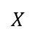
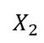
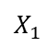
3. Method
| Proposed Architecture
grad
cosine similarity
stop-grad
0.7
0.1
0.0
0.0
0.1
0.0
0.1
0.0
predictor
encoder
encoder
encoder
classifier
Pop
projector
projector
backbone
backbone
freezed
finetuned
$$X_{1}$$
$$X_{2}$$
augment
$$X$$
augment
Raw Audio
or
Spectrogram Image

Slide 13
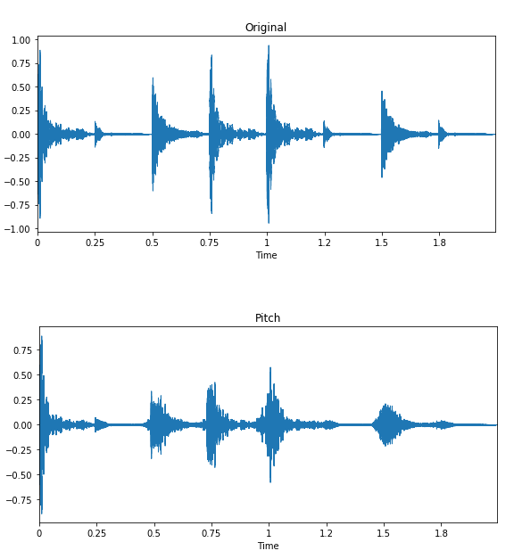
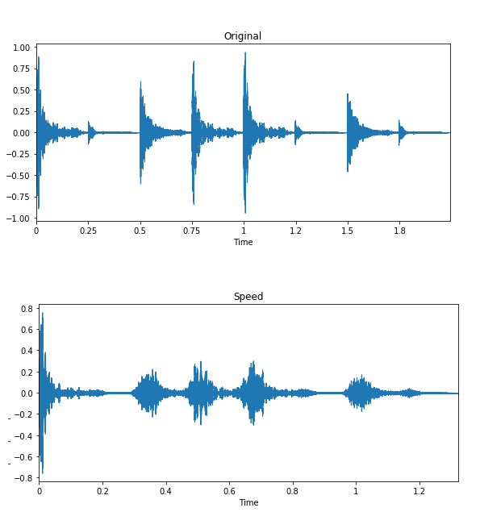
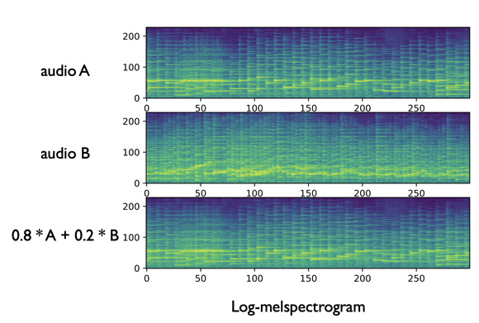
3. Method
| Audio Augmentation
1. Mix-up
2. Pitch Shift
3. Time Stretching

Slide 14
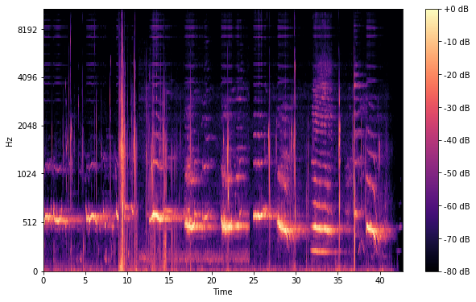
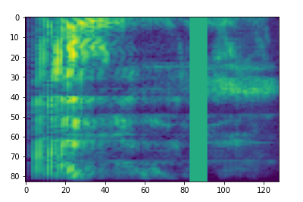
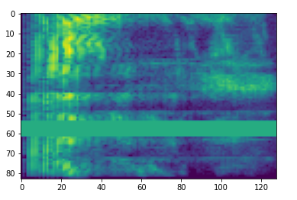
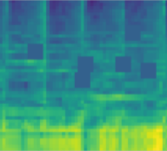
3. Method
| Image Augmentation
1. Mix-Up & CutMix
2. Flip
3. Masking
Origin
VFlip
2. CutOut
HFlip

Slide 15
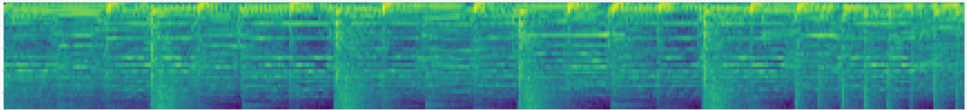
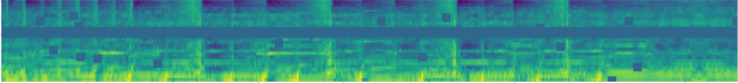
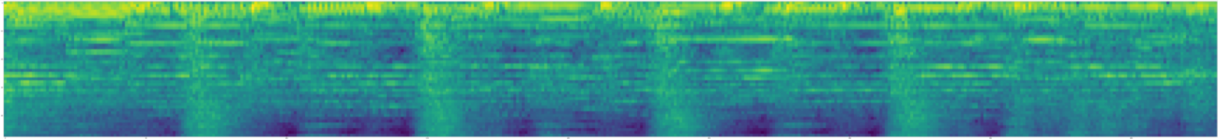
3. Method
| Augmentation Results
Original
Image Aug
Audio Aug

Slide 16
4. Experiment

Slide 17
4. Experiment
| Dataset
Pretraining (SSL) Dataset
: FMA_medium : 25,000 tracks of 30s, 16 unbalanced genres
( Rock, Electronic, Experimental, Hip-Hop, Classical, Folk, Old-Time, Jazz, Instrumental, Pop, Country, RnB, Spoken, Blues, Easy Listening, International )
Finetuning (Transfer Learning) Dataset
: FMA_small : 8,000 tracks of 30s, 8 balanced genres
( Rock, Electronic, Experimental, Hip-Hop, Folk, Instrumental, Pop, International )
| Experimental Setup
[Table 1] Pre-training Setting
Epochs | 100 | Momentum | 0.9
Batch Size | 64 | Weight Decay | 1e-4
Optimizer | SGD | Backbone | [‘resnet50’, ‘resnet101’, ‘resnet152’]
Learning Rate | 0.05 | Augmentation | [‘audio’, ‘image’]
GPU | Single | Dataset | FMA_small FMA_medium
[Table 2] Transfer Learning Setting
Epochs | 50 | Momentum | 0.9
Batch Size | 64 | Weight Decay | 1e-4
Optimizer | SGD | Learning Rate | 0.0001
GPU | Single | Dataset | FMA_small

Slide 18
4. Experiment
| Experiment Result – Audio Aug vs. Image Aug
[Table 3] Baseline And Our Works
Backbone | Augmentation | Pretraining Dataset | Transfer Learning Dataset | Acc | Recall | Precision | F1
Resnet50 | Audio(Baseline) | FMA_medium | FMA_small | 0.324 | 0.325 | 0.314 | 0.319
 | Image(Ours) | FMA_medium | FMA_small | 0.354 | 0.359 | 0.361 | 0.359
 | Audio(Baseline) | FMA_small | FMA_small | 0.253 | 0.255 | 0.229 | 0.241
 | Image(Ours) | FMA_small | FMA_small | 0.262 | 0.267 | 0.279 | 0.273
Hu et al., [10]
RNN based model
They proposed Adaptively Scaled Recurrent Neural Networks (ASRNN)
Tran et al., [11]
2D Attention based model
They used convolution networks as feature extractor
[Table 4] Comparison to Supervised Learning
Model | Training | Accuracy
Hu et al., | Supervised Learning | 42.4
Tran et al., |  | 42.67±1.23
[10] Hu, Hao, Liqiang Wang, and Guo-Jun Qi. "Learning to adaptively scale recurrent neural networks." Proceedings of the AAAI Conference on Artificial Intelligence. Vol. 33. No. 01. 2019.
[11] Tran, Dat Thanh, et al. "Attention-based neural bag-of-features learning for sequence data." IEEE Access 10 (2022): 45542-45552.

Slide 19
4. Experiment
| Experiment Result – Various Backbone Network
[Table 5] Various Backbone And Augmentation
Backbone | Augmentation | Pretraining Dataset | Transfer Learning Dataset | Accuracy | Recall | Precision | F1
Resnet50 | Audio | FMA_medium | FMA_small | 0.324 | 0.325 | 0.314 | 0.319
 | Image(Ours) |  |  | 0.354 | 0.359 | 0.361 | 0.359
 | Audio | FMA_small |  | 0.253 | 0.255 | 0.229 | 0.241
 | Image(Ours) |  |  | 0.262 | 0.267 | 0.279 | 0.273
Resnet101 | Audio | FMA_medium |  | 0.332 | 0.335 | 0.336 | 0.335
 | Image(Ours) |  |  | 0.327 | 0.331 | 0.331 | 0.330
 | Audio | FMA_small |  | 0.242 | 0.246 | 0.219 | 0.231
 | Image(Ours) |  |  | 0.270 | 0.278 | 0.272 | 0.274
Resnet152 | Audio | FMA_medium |  | 0.352 | 0.353 | 0.352 | 0.352
 | Image(Ours) |  |  | 0.357 | 0.362 | 0.356 | 0.358
 | Audio | FMA_small |  | 0.234 | 0.238 | 0.208 | 0.222
 | Image(Ours) |  |  | 0.251 | 0.258 | 0.222 | 0.239
※ Bold means that it performed best among the evaluation metrics.
※ Underline means the metrics that performed better among the two models using the same backbone and data.

Slide 20
5. Discussion & Conclusion

Slide 21
5. Discussion & Conclusion
| Discussion
Due to the lack of computing resources, pre-train could not be performed using larger data.
FMA_medium(25K, ours), Google AudioSet(2.1M, Wu et al.,), Million Songs(1M, Zhao et al.,)
Not identified the effect of each image augmentation or their combination on improving classification performance
During the transfer learning stage, genre classification was not performed using other data
| Conclusion
Contribution
The first studies to use the Image Augmentation technique for audio data in the SSL application of the music domain
Drives slightly better performance compared to the performance using audio Augmentation
Fully worth attempting an image augmentation methodology for SSL learning using audio data
Image Augmentation is the most researched area, so it can be applied to Audio in various ways in the future
Easy to interpret because visualization is possible.

Slide 22
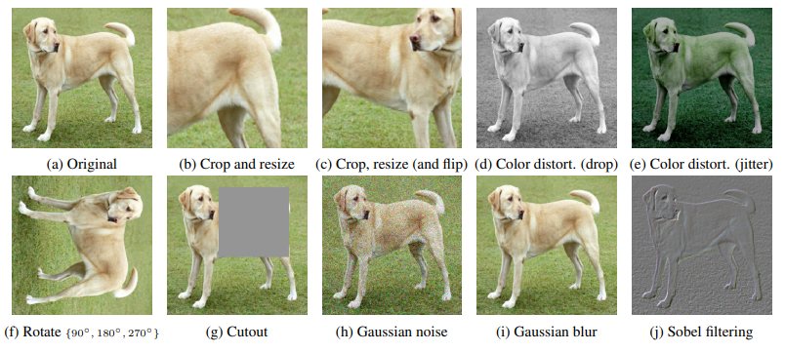
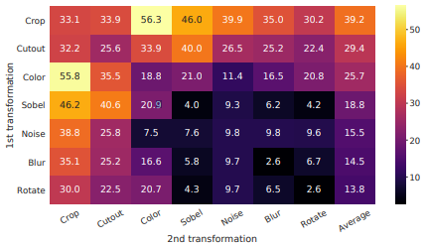
5. Discussion & Conclusion
| Conclusion
Future Work
More diverse Self-Training structures and methodologies can be introduced
MoCo v3, SSL-Swin(MoBY), DINO
Apply more diverse Image Augmentation to the Audio Spectrogram
Gauss Noise, Cutout, Blur …
Experiments can be conducted by changing the combination of Augmentation to compare and analyze the impact on performance
Source: Chen, Ting et al. “A Simple Framework for Contrastive Learning of Visual Representations.” ArXiv abs/2002.05709 (2020): n. pag.

Slide 23
Thank You
Q & A

